Slide 1

WHAT IS THE IMPACT OF MINIMUM WAGE INCREASES ON EMPLOYMENT RATES IN THE SERVICE SECTOR ACROSS U.S. STATES
BETWEEN 2014 AND 2023?

Slide 2

DATA RETRIEVAL
Minimum wage data ($):
U.S. Department of Labor
50 states, no territories
take average for states with more than 1 minimum wage amounts
Unemployment rate data (%):
U.S. Bureau of Labor Statistics
seasonally adjusted
Notes:
The minimum wage in New York City, Nassau County, Suffolk County, and Westchester County is $16.00 per hour. The minimum wage in the remainder of the state is $15.00 per hour.
Seasonal adjustment is a statistical technique that attempts to measure and remove the influences of predictable seasonal patterns.

Slide 3
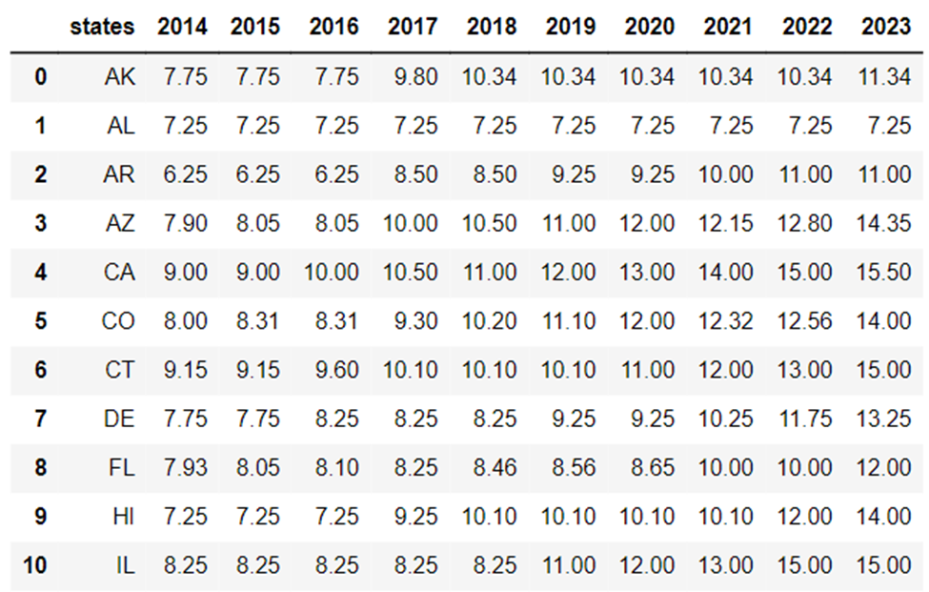
Notes:
Seasonal adjustment is a statistical technique that attempts to measure and remove the influences of predictable seasonal patterns.

Slide 4
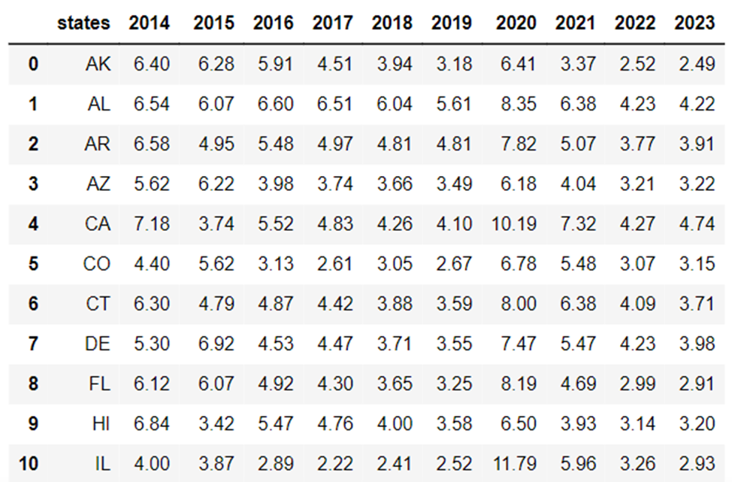

Slide 5
Insights from minimum wage data:
01
Federal minimum wage has been $7.25 since 2009
02
13 states that haven’t raised minimum wage for the past 10 years, including Pennsylvania
03
California, Washington made substantial jumps reflecting high cost of living
04
Coastal states generally have higher minimum wages compared to the southern and midwestern states
05
2021 witnessed significant minimum wage increases from many states.
o California: Increased from $14.00 to $15.00
o Virginia: Increased from $7.25 to $12.00
o New Jersey: Increased from $12.00 to $13.00
Notes:
a significant legislative push for higher wages.

Slide 6
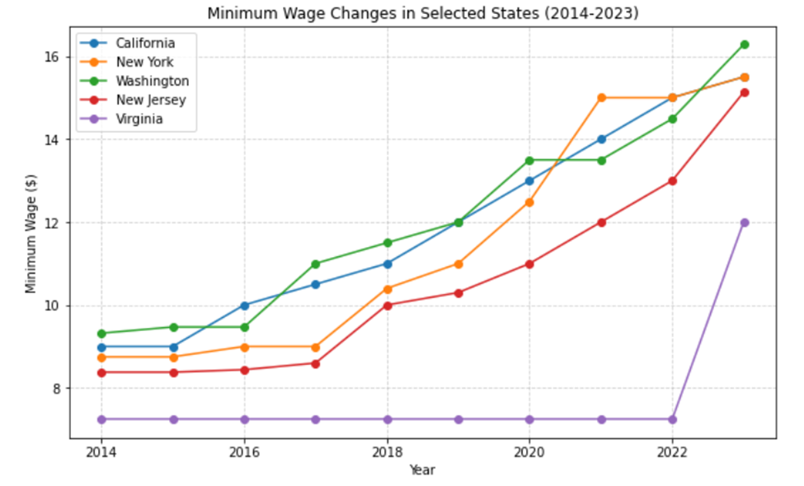

Slide 7
Insights from unemployment data:
01
Most states show a gradual decline in unemployment rates from 2014 to 2019
02
In 2020, there’s a significant increase in unemployment rates across almost all states (especially Hawaii and Nevada), largely due to the COVID-19 pandemic
03
From 2021, many states show a recovery trend, with rates starting to decline again. However, the rates are mostly still above pre-pandemic levels.
Notes:
a significant legislative push for higher wages.
those heavily reply on tourism

Slide 8
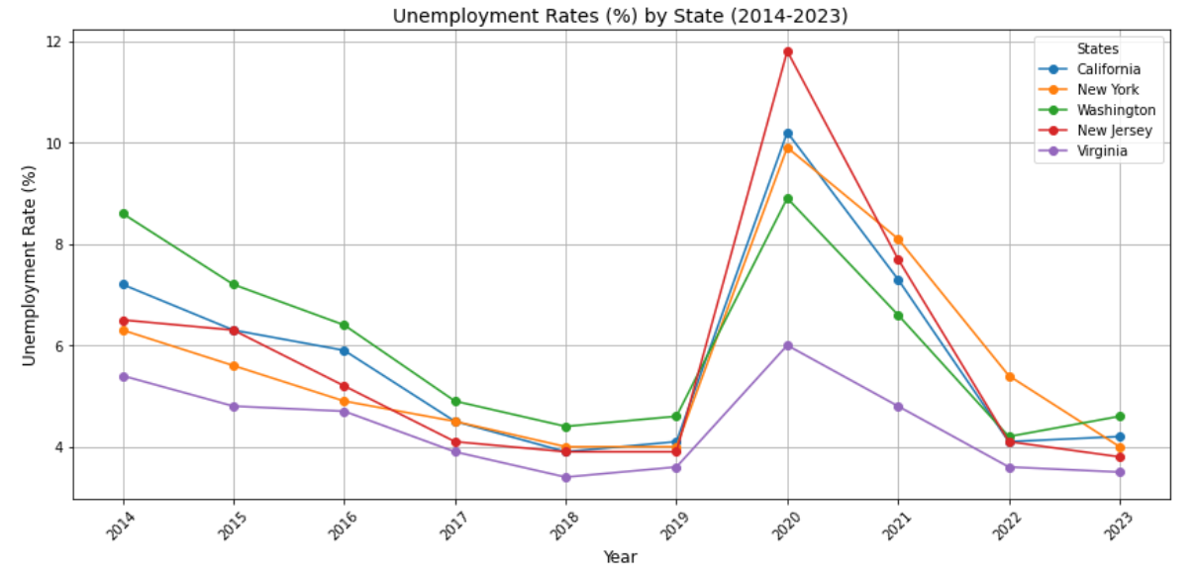

Slide 9
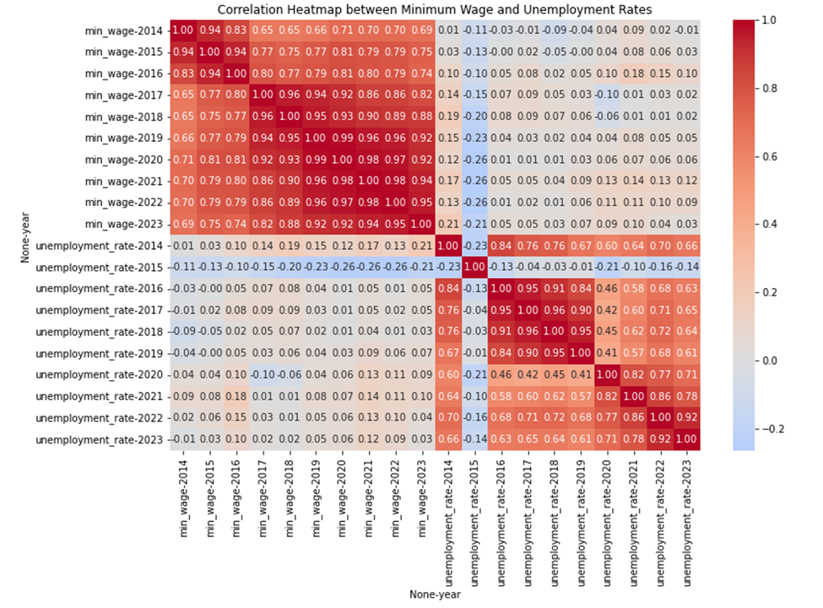
Correlation Heat Map
The values range from -1 to 1
The correlations between different years of minimum wage levels are consistently high, suggesting that changes in minimum wage levels are often similar from one year to the next
Correlation value for minimum wage and unemployment rate in 2021 is 0.14 (not significant)

Slide 10


Implication for Stakeholders
Policymakers can consider raising the minimum wage without necessarily worrying about negative employment impacts. This could lead to a better quality of life for low-wage workers, as higher wages may reduce poverty and improve economic security without sacrificing jobs.
This finding can provide support for minimum wage campaigns with more confidence that it will not negatively affect job availability.

Slide 11



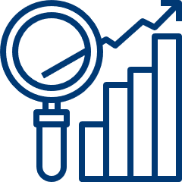

Ethical, Legal, and Societal Implications
It raises ethical questions about whether society is doing enough to support low-wage workers and reduce inequality.
IIt suggests that other mechanisms beyond just wage increases are needed to address systemic economic disparities.
Legal frameworks around minimum wage are often a balance between worker protection and economic concerns. If evidence shows no adverse employment effects, existing minimum wage laws may need to be revisited and updated to better protect workers.

Slide 12
Thank You

